Slide 1

Predicting UFC Fight Outcomes with Machine Learning: A Case Study
Navin Sanjay
April 2023

Slide 2
Purpose
Predictive modelling was used to find the likelihood of a match being by KO/Submission or by Judge Decision between two fighters.
Target Audience:
Betting agencies can adjust their odds accordingly
Individuals can use this information when betting

Slide 3
Background
The UFC (Ultimate Fighting Championship) is a mixed martial arts organization that features highly skilled fighters from around the world competing against each other in a variety of weight classes.
Data was taken from the last 10 years of the Lightweight category and assessed to predict the likelihood of a match resulting in a KO/Submission or Judge Decision.
Notes:
KO: Knockout
Submission: Fighter causes opponent to give up
Judge Decision: Outcome of the fight is determined by three judges scoring each round based on the fighters' performance.

Slide 4
Data Overview and Data Pre-processing

Slide 5
Overview of Data
Data was obtained from Kaggle
https://www.kaggle.com/datasets/fatismajli/ufc-data
UFC Events Data
Data on each event and their results
771 rows x 11 cols
UFC Fighter Data
Data on each UFC fighter and their attributes
1692 rows x 8 cols

Slide 6
Overview of Data – UFC Fighter Data
 | First Name | Last Name | Nickname | Height | Weight | Reach | Stance | Wins | Losses | Draws
0 | Tom | Aaron | NaN | -- | 155 lbs. | -- | NaN | 5 | 3 | 0
1 | Danny | Abbadi | The Assassin | 5' 11" | 155 lbs. | -- | Orthodox | 4 | 6 | 0
2 | Nariman | Abbasov | Bayraktar | 5' 8" | 155 lbs. | 66.0" | Orthodox | 28 | 4 | 0
3 | David | Abbott | Tank | 6' 0" | 265 lbs. | -- | Switch | 10 | 15 | 0
4 | Hamdy | Abdelwahab | The Hammer | 6' 2" | 264 lbs. | 72.0" | Southpaw | 5 | 0 | 0
Notes:
Explain each thing
First Name
Last Name
Nickname
Height
Weight
Reach
Stance
(# of) Wins
(# of) Losses
(# of) Draws

Slide 7
Overview of Data – UFC Event Data
 | Event Name | Event Date | Result | Fighter1 | Fighter2 | KD | Strikes | TD | Sub | Weight Class | Method | Round | Time
11 | UFC 286: Edwards vs. Usman 3 | 2023-03-18 | Justin Gaethje | Justin Gaethje | Rafael Fiziev | 0-0 | 103-97 | 1-0 | 0-0 | Lightweight | M-DEC | 3 | 5.000000
16 | UFC 286: Edwards vs. Usman 3 | 2023-03-18 | Chris Duncan | Chris Duncan | Omar Morales | 0-0 | 53-47 | 5-0 | 0-0 | Lightweight | S-DEC | 3 | 5.000000
17 | UFC 286: Edwards vs. Usman 3 | 2023-03-18 | Yanal Ashmouz | Yanal Ashmouz | Sam Patterson | 0-0 | 15-2 | 1-0 | 0-0 | Lightweight | KO/TKO-Punches | 1 | 1.250000
23 | UFC 286: Edwards vs. Usman 3 | 2023-03-18 | Draw | Jai Herbert | Ludovit Klein | 0-0 | 43-47 | 1-2 | 0-0 | Lightweight | M-DEC | 3 | 5.000000
41 | UFC 285: Jones vs. Gane | 2023-03-04 | Mateusz Gamrot | Mateusz Gamrot | Jalin Turner | 0-1 | 29-40 | 4-0 | 0-0 | Lightweight | S-DEC | 3 | 5.000000
Notes:
Event Name
Event Date
Result (name of winner or draw)
Fighter1
Fighter2
KD (# knockdowns per fighter)
Strikes (# landed strikes per fighter)
TD (# takedowns per fighter)
Sub (# submission attempts per fighter)
Weight Class
Method
Round
Time

Slide 8
Overview of Data – Data Cleaning
Object (string)
Integers & Floats
 | First Name | Last Name | Nickname | Height | Weight | Reach | Stance | Wins | Losses | Draws
0 | Tom | Aaron | NaN | -- | 155 lbs. | -- | NaN | 5 | 3 | 0
1 | Danny | Abbadi | The Assassin | 5' 11" | 155 lbs. | -- | Orthodox | 4 | 6 | 0
2 | Nariman | Abbasov | Bayraktar | 5' 8" | 155 lbs. | 66.0" | Orthodox | 28 | 4 | 0
3 | David | Abbott | Tank | 6' 0" | 265 lbs. | -- | Switch | 10 | 15 | 0
4 | Hamdy | Abdelwahab | The Hammer | 6' 2" | 264 lbs. | 72.0" | Southpaw | 5 | 0 | 0
Notes:
Only cared about the attributes
Didn’t need Nickname, nor stance
Also I removed any rows that had no data in them, as I needed only the fighters who had data so I can make effective comparisons
The datasets had a mixture of Objects and Integers/Floats

Slide 9
Overview of Data – Data Cleaning
Target variable
 | Event Name | Event Date | Result | Fighter1 | Fighter2 | KD | Strikes | TD | Sub | Weight Class | Method | Round | Time
11 | UFC 286: Edwards vs. Usman 3 | 2023-03-18 | Justin Gaethje | Justin Gaethje | Rafael Fiziev | 0-0 | 103-97 | 1-0 | 0-0 | Lightweight | M-DEC | 3 | 5.000000
16 | UFC 286: Edwards vs. Usman 3 | 2023-03-18 | Chris Duncan | Chris Duncan | Omar Morales | 0-0 | 53-47 | 5-0 | 0-0 | Lightweight | S-DEC | 3 | 5.000000
17 | UFC 286: Edwards vs. Usman 3 | 2023-03-18 | Yanal Ashmouz | Yanal Ashmouz | Sam Patterson | 0-0 | 15-2 | 1-0 | 0-0 | Lightweight | KO/TKO-Punches | 1 | 1.250000
23 | UFC 286: Edwards vs. Usman 3 | 2023-03-18 | Draw | Jai Herbert | Ludovit Klein | 0-0 | 43-47 | 1-2 | 0-0 | Lightweight | M-DEC | 3 | 5.000000
41 | UFC 285: Jones vs. Gane | 2023-03-04 | Mateusz Gamrot | Mateusz Gamrot | Jalin Turner | 0-1 | 29-40 | 4-0 | 0-0 | Lightweight | S-DEC | 3 | 5.000000
Notes:
In the UFC events data, we also have a mixture of objects and integers/floats
I removed the events name col as didn’t need
I also removed any draws as I was only interested in how someone won
I removed any overturned decisions and all wins by disqualification
The Target Variable for my Predictive Modelling will be the method of how the fighter won. This would later be changed into 1’s and 0. 1 Representing a KO/Sub and 0 representing anything else

Slide 10
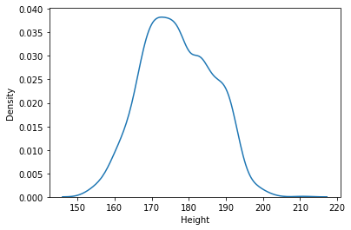
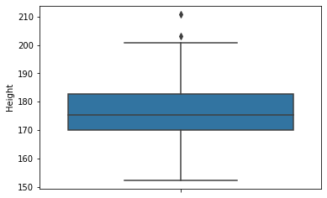
Overview of Data – Summary Statistics UFC Fighter Summary Statistics
Notes:
Average height of ufc fighters is around 165 – 180 cm
The y-axis in a density plot is the probability density function for the kernel density estimation. However, we need to be careful to specify this is a probability density and not a probability. The difference is the probability density is the probability per unit on the x-axis.

Slide 11
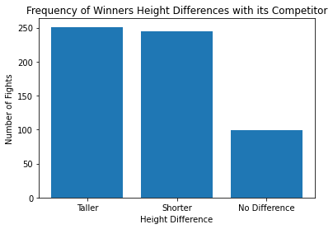
Overview of Data – Summary Statistics UFC Fighter Summary Statistics
Notes:
I wanted to check whether a difference in the attribvutes between a winner of a match vs his competitor would signal the likelihood of a win.
This proved to me that the difference in Height doesn’t play a significant factor in the outcome, as many fighters who were shorter than their opponent had similar amount of total wins.

Slide 12
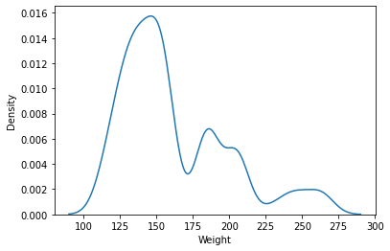
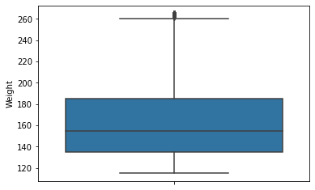
Overview of Data – Summary Statistics UFC Fighter Summary Statistics
Notes:
8 classes: - This project focuses on Lightweight which is 145 pounds to 155 pounds
Flyweight 115 lb (52.2 kg; 8.2 st) 125 lb (56.7 kg; 8.9 st)
Bantamweight 125 lb (56.7 kg; 8.9 st) 135 lb (61.2 kg; 9.6 st)
Featherweight 135 lb (61.2 kg; 9.6 st) 145 lb (65.8 kg; 10.4 st)
Lightweight 145 lb (65.8 kg; 10.4 st) 155 lb (70.3 kg; 11.1 st)
Welterweight 155 lb (70.3 kg; 11.1 st) 170 lb (77.1 kg; 12.1 st)
Middleweight 170 lb (77.1 kg; 12.1 st) 185 lb (83.9 kg; 13.2 st)
Light Heavyweight 185 lb (83.9 kg; 13.2 st) 205 lb (93.0 kg; 14.6 st)
Heavyweight 205 lb (93.0 kg; 14.6 st) 265 lb (120.2 kg; 18.9 st)

Slide 13
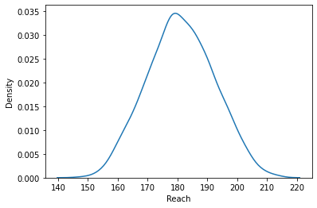
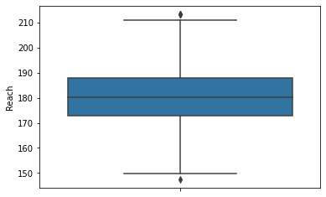
Overview of Data – Summary Statistics UFC Fighter Summary Statistics
Notes:
Average Reach is ~180 cm

Slide 14
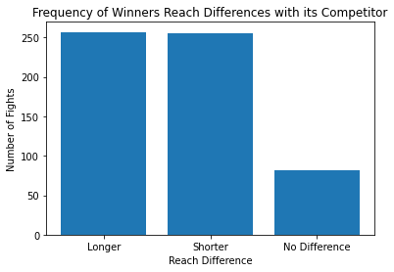
Overview of Data – Summary Statistics UFC Fighter Summary Statistics
Notes:
Again, similar situation with reach. The difference doesn’t play a signiciant factor in the amount of wins seen.

Slide 15
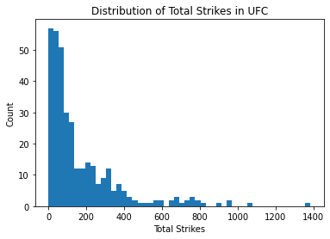
Overview of Data – Summary Statistics UFC Summary Statistics
Notes:
Looking at the Distribution of total strikes of fighters in the last 10 years.
There are a lot more of fighters that have less that 500 total strikes landed than above. - Could be due to skill level, fighting style

Slide 16
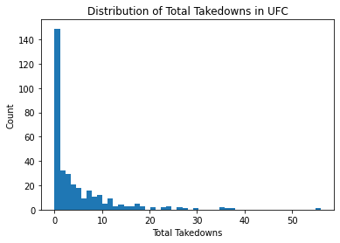
Overview of Data – Summary Statistics UFC Summary Statistics
Notes:
Looking at the Distribution of total takedowns of fighters in the last 10 years.
Similar situation with total takedowns.
This could suggest that there wont be a huge difference between fight match ups, generally speaking.

Slide 17
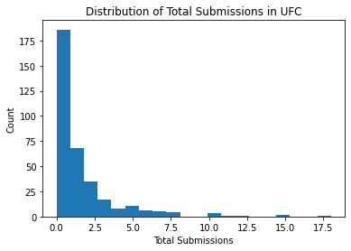
Overview of Data – Summary Statistics UFC Summary Statistics
Notes:
Looking at the Distribution of total strikes of fighters in the last 10 years

Slide 18
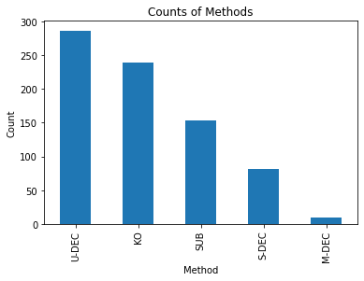
Overview of Data – Summary Statistics UFC Summary Statistics
Notes:
The frequency of a fight ending in each method.
In the light weight category there seems to be more an even amount between decision based and KO/Sub

Slide 19
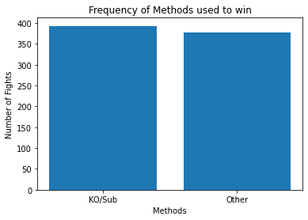
Overview of Data – Summary Statistics UFC Summary Statistics
Notes:
The frequency of a fight ending in each method.
In the light weight category there seems to be more Decision based (Unanimous) wins than KO. Which makes the betting odds even higher if a match does end in a KO/Sub

Slide 20
Feature Selection

Slide 21
Most relevant features for the Predictive Model
Fighter1 and Fighter2 Match
Method of Win – Predictor Variable
KO/Sub vs Anything Else
Total Strike Difference between fighters (For the last 10 years)
Total Takedown Difference
Total Submission Difference
Total Height Difference
Total Reach Difference
Total # Wins Difference
Total Experience Difference (Number of fights in the last 10 years)
Average Fight Time Difference
Total # KO wins Difference

Slide 22
Most relevant features for the Predictive Model
 | strike_diff | td_diff | sub_diff | Height_Diff | Reach_Diff | Wins_Diff | Exp_Diff | avg_fighttime_diff | ko_diff
0 | 323 | -1 | 0 | 7.62 | -2.54 | 12 | 14 | 1.37 | 5
1 | -122 | 4 | 0 | -2.54 | -5.08 | -1 | -4 | -2.21 | -1
2 | 13 | 1 | 0 | -15.24 | -25.40 | -3 | -6 | -0 | 0
3 | 41 | 24 | -5 | -12.70 | -17.78 | 9 | 5 | -5.35 | -1
4 | -26 | 11 | -1 | 2.54 | 0.00 | 6 | 10 | -0 | 0
... | ... | ... | ... | ... | ... | ... | ... | ... | ...
589 | 146 | -1 | 0 | -2.54 | -7.62 | -26 | -41 | -5.15 | -2
590 | -373 | -9 | 3 | -7.62 | -2.54 | -12 | -19 | 0.51 | -5
591 | -40 | -1 | 0 | 0.00 | 10.16 | 5 | 0 | 4.30 | -1
592 | 561 | 55 | 7 | 7.62 | 0.00 | 8 | 0 | -9.34 | 3
593 | 729 | 4 | 1 | -2.54 | 7.62 | 3 | 11 | -8.14 | 6
Notes:
- Important to note, I also applied the Feature Engineering track of Scaling the data so that the model performs better.

Slide 23
Most relevant features for the Predictive Model
 | Method
Method | 1.00
strike_diff | -0.018
td_diff | -0.027
sub_diff | 0.15
Height_Diff | 0.026
Reach_Diff | 0.045
Wins_Diff | 0.037
Exp_Diff | 0.029
avg_fighttime_diff | -0.129
ko_diff | 0.058
Notes:
The negative coefficients for strike_diff and td_diff suggest that fewer strikes landed and takedowns can lead to a lower probability of winning by KO,
while the positive coefficients for sub_diff, Height_Diff, Reach_Diff, Wins_Diff, Exp_Diff, and ko_diff suggest that these factors can increase the probability of winning.
The negative coefficient for avg_fighttime_diff suggests that longer average fight time can decrease the probability of winning by KO.
Most of the values are small, indicating that there is little to no correlation between the features.

Slide 24
Model Selection and Training

Slide 25
Different Models Used
For the predictive modelling problem of classifying UFC fights as ending in a KO/Sub or by Decision, three popular binary classification algorithms were selected:
Logistic Regression
Support Vector Machine
Naïve Bayes (Gaussian)
The performance of models was compared based on:
Accuracy Score
AUC - ROC
F1-Score
The models were trained on historical fight data (the last 10 years)
Notes:
Accuracy measures the overall correctness of the model's predictions, i.e., the number of correct predictions divided by the total number of predictions. It is a simple metric to interpret but can be misleading when classes are imbalanced.
AUC-ROC (Area Under the Receiver Operating Characteristic Curve) is a measure of the model's ability to distinguish between positive and negative classes, independent of the threshold used to make the prediction. AUC-ROC is a good metric to use when classes are imbalanced, and the model needs to prioritize one class over the other.
F1-score is the harmonic mean of precision and recall. It is a good metric to use when both precision and recall are important, and there is a trade-off between them.
In the context of predicting whether a fight will end in a KO/Submission or by Decision, all three metrics are relevant. Accuracy is useful to measure the overall performance of the model. AUC-ROC is useful when there is class imbalance and it is important to distinguish between positive and negative classes. F1-score is useful when both precision and recall are important.

Slide 26
Results and Analysis

Slide 27
Model Comparison
Model | Accuracy Score | AUC – ROC | F1-Score
Logistic Regression | 67.2% | 69% | 67%
Support Vector Machine | 69.7% | 71% | 67%
Naive Bayes | 63.9% | 67% | 61%
Notes:
SVM Scored the highest in most performance metrics. This was the final model I chose
In the context of predicting whether a fight will end in a KO/Submission or by Decision, all three metrics are relevant. Accuracy is useful to measure the overall performance of the model. AUC-ROC is useful when there is class imbalance and it is important to distinguish between positive and negative classes. F1-score is useful when both precision and recall are important.
For example, if the goal is to minimize false positives, then precision may be the most important metric to consider. Conversely, if the goal is to minimize false negatives, then recall may be the most important metric.
- True Positive: Correctly predicted a KO/Sub of a fight
- True Negative: Correctly predicted another method of a fight
- False Positive: Falsely predicted a KO/Sub
- False Negative: Falsely predicted another method

Slide 28
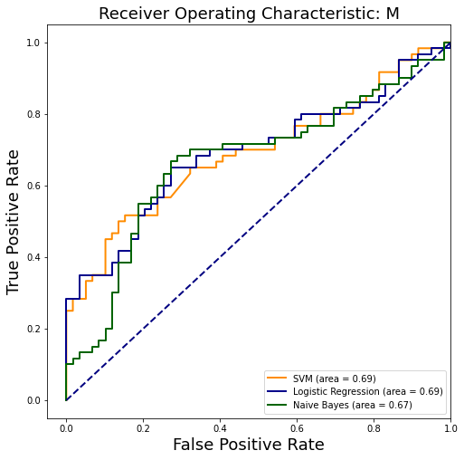
Notes:
SVM Scored the highest in most performance metrics. This was the final model I chose

Slide 29
Model Limitations
Limited Data:
My data was only on the last 10 years
If there is few data of a certain fighter the model may not be able to make accurate predictions for those cases
Combat Sport Unpredictability:
Combat sports are known for their unpredictability as it just takes one hit to knock someone out.
Binary Classified:
In this project I only looked at whether it was a KO/Sub or Decision. However, it would be better to look at it as a multi-class problem.
Interpretability:
SVM’s (The model I chose as the best) are black box, therefore its difficult to interpret how the model is making its predictions

Slide 30
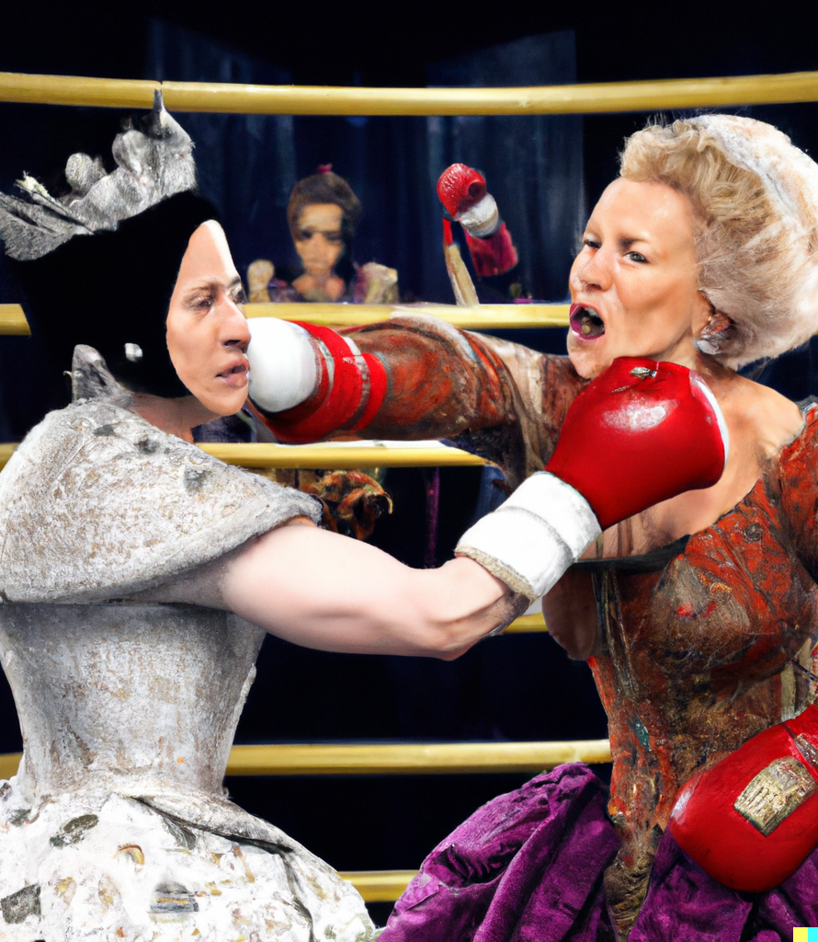
Conclusion
In summary, I have demonstrated the power of predictive modelling in the context of UFC fights, showing how a combination of data pre-processing, feature engineering, and model selection can yield accurate predictions of fight outcomes.
This approach has important implications not just for UFC but also for other sports, where accurate predictions can inform everything from betting odds to training strategies.

Slide 31
Conclusion
While the model has shown promising results, there is always room for improvement, further exploration and refinement of predictive models can be done to further improve the accuracy.
By continuing to refine our models and better understand the factors that influence fight outcomes, we can help fighters, coaches, fans and businesses alike make more informed decisions and gain deeper insights into the complex world of combat sports.

Slide 32
Tested on recent Fight
Fighter1 = Clay Gaudia
Fighter2 = Rafa Garcia
Model Predicted that the result would be “0”
Predicting that the match would be by Decision.

Slide 33
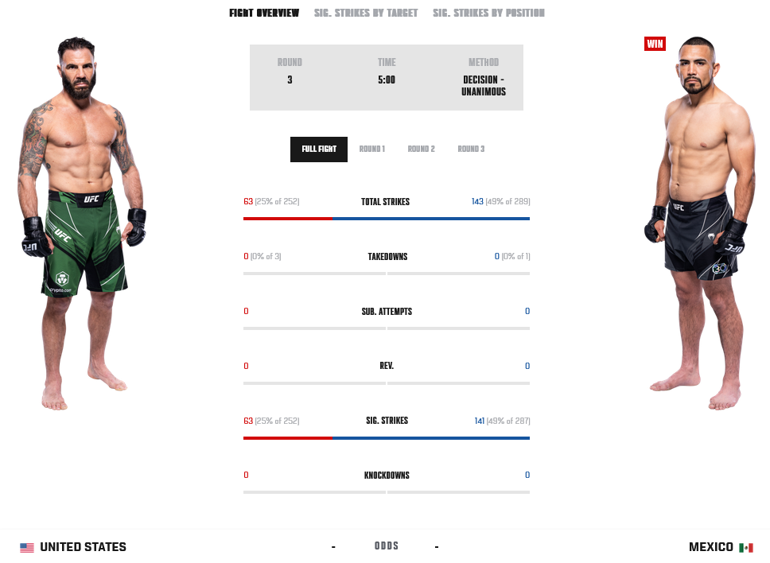
Tested on recent Fight

Slide 34
Thank you!

